Slide 1
INFO 5731 Team Presentation
Natural language processing of behavior analysis citations.
Project Mentor: Nicole Blank
Project Leader: Tejas Kulkarni
Project Members: Bharath Suroju, Anand Pandarapagada, Mayuri Joshi, Shruti Mathur

Slide 2
Table of Content
Introduction
Purpose of Behavior analysis Citations
Data to be Retrieved
Data Retrieval Approaches
Data Retrieval Process and Results
Data Analysis
Conclusion

Slide 3
Introduction
The key role of behavior analyst is to integrate best available research developments with their work to provide the best services to the client.
Across disciplines in which behavior analyst work, there has been consistent gap between what is being researched and implemented.
Unfortunately, the limited access to the research development artifacts makes it hard for behavior analyst to work more effectively.
This project seeks to gather all these scholarly and scientific artifacts that will improve the credibility of the services offered by behavior analysts.
Therefore, having the significant and systematic access to research developments disseminated through formal and informal channels can help to structure their practice settings explicitly in decision making and thereby improving outcomes.

Slide 4
Purpose of Behavior analysis Citations
Problem Statement:
What are the various scholarly and scientific artifacts (e.g., journal articles) that comprise the knowledge infrastructure of the field of behavior analysis?
Below points helps to answer problem statement :
This project aims to combine all the references in articles published in nine flagship behavior analytic journals. These journals are mainly related to the knowledge infrastructure of the field of behavior analysis.
Gathering all the artifacts in one file would allow us to review and analyze the formal and informal channels that disseminates artifacts.
It will also able to find how many of that references are accessible by behavior analytic practitioners who are not associated with any businesses or organization.

Slide 5
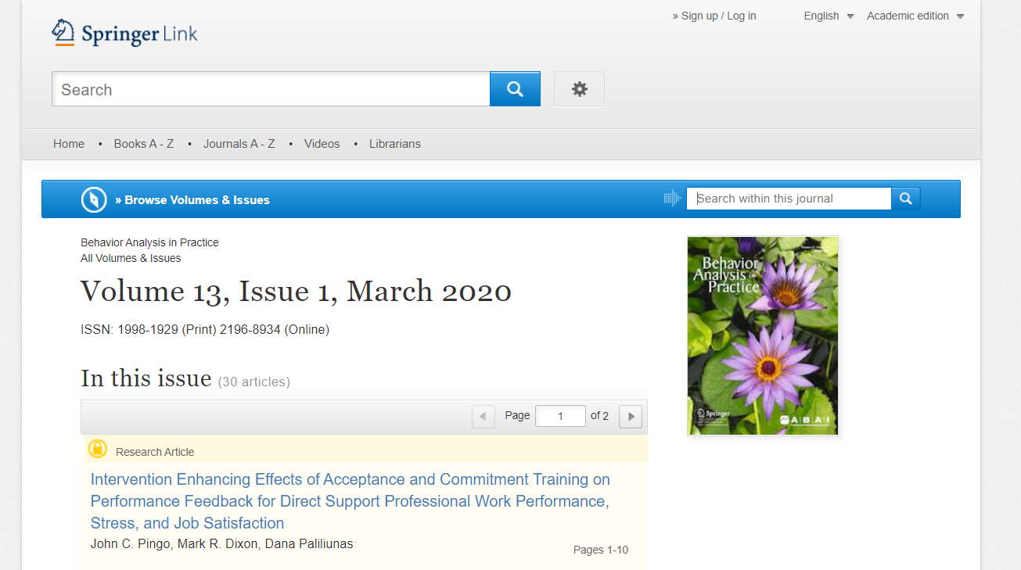
Data to be Retrieved
We are extracting references from nine flagship journals that comprises the scope of peer-reviewed journals exclusively publishing behavior analytic research and supported by behavior analytic organizations.
Journals
Analysis of Verbal Behavior
Behavior Analysis in Practice
Behavior and Social Issues
European Journal of Behavior Analysis
Journal of Applied Behavior Analysis
Journal of the Experimental Analysis of Behavior
Mexican Journal of Behavior Analysis
Perspectives on Behavior Science
Psychological Record
Reference Article
Extracted Reference Data
Journals
Reference Article
Reference Data
Journal Title
Article Title
Author Name
Year

Slide 6
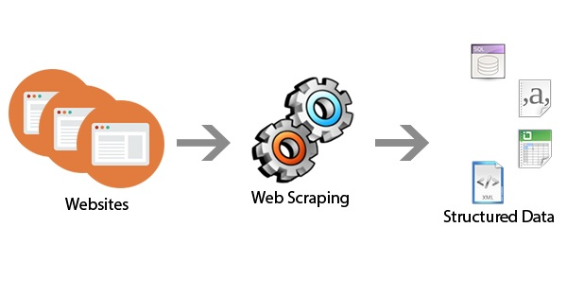
Data Retrieval Approaches
Each journal composed of multiple volumes with the number of published issues. The references that need to be extracted, are present in the articles of these issues. The format of the journals’ articles varies from one another which leads to follow different methods and packages for extracting the references.
References are collected from articles by scraping web pages of Journals published on springer.com and onlinelibrary.wiley.com using
Beautiful Soup Package.
Selenium.
Regular Expressions. (Regex)

Slide 7
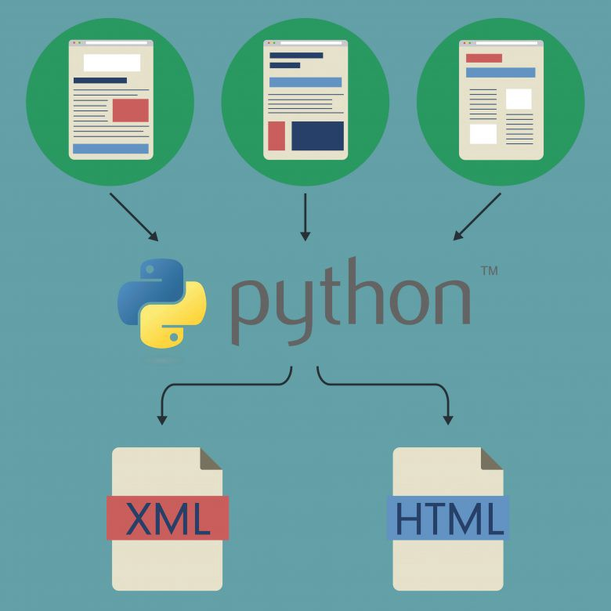
Beautiful Soup
Beautiful Soup is the best Library to scrap the data from a particular website or the Internet. And it is most comfortable to work on also. It parses and extracts structured data from HTML and XML documents.

Slide 8
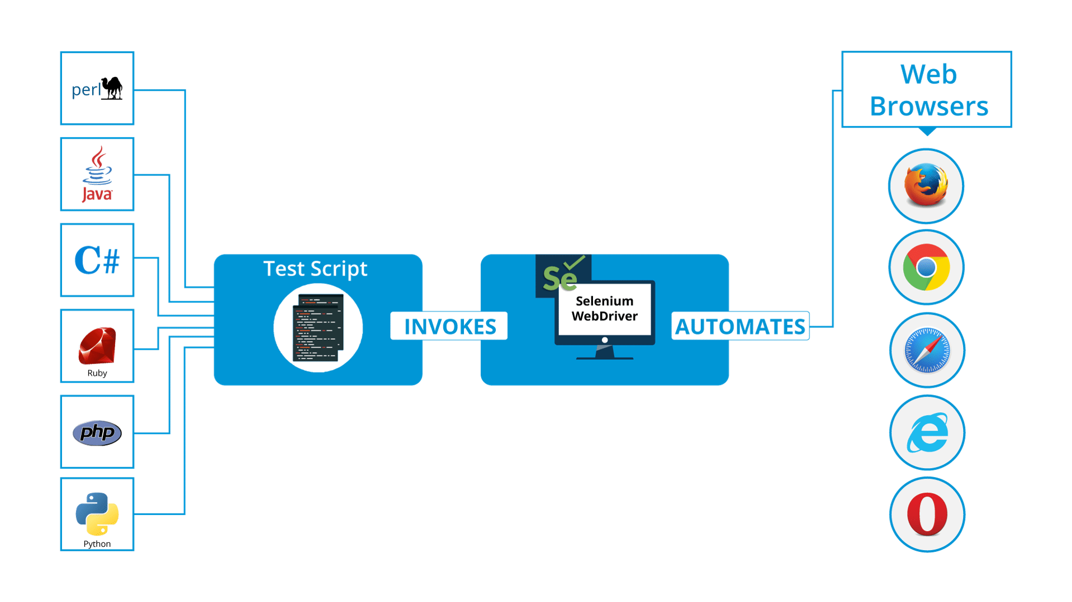
Selenium
Selenium is a framework which is designed to automate test for web applications. With the help of python script it controls the browser interactions automatically such as link clicks and form submissions.

Slide 9
Regular Expressions
Regular expressions, also called regex is widely used in natural language processing, web applications that require validating string input.
A regex pattern is a special language used to represent generic text, numbers or symbols so it can be used to extract texts that conform to that pattern.
There are various parameters which are commonly used in regular expression i.e.
Pattern
This is the regular expression to be matched.
String
This is the string, which would be searched to match the pattern at the beginning of string.
Flags
You can specify different flags using bitwise OR (|). These are modifiers, which are listed in the table below.

Slide 10
Data Retrieval Process and Results
Process 1
In this process we are extracting references using Beautiful soup,Urlib.request module and Regular expressions.
This process is used to collect references from below Journals –
Analysis of Verbal Behavior
Behavior Analysis in Practice
Behavior and Social Issues
European Journal of Behavior Analysis

Slide 11
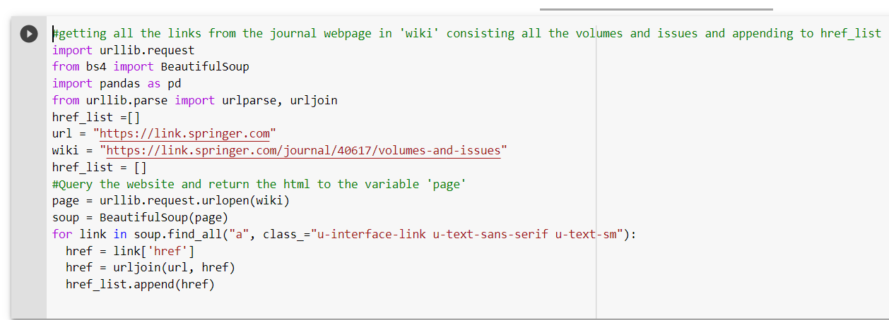
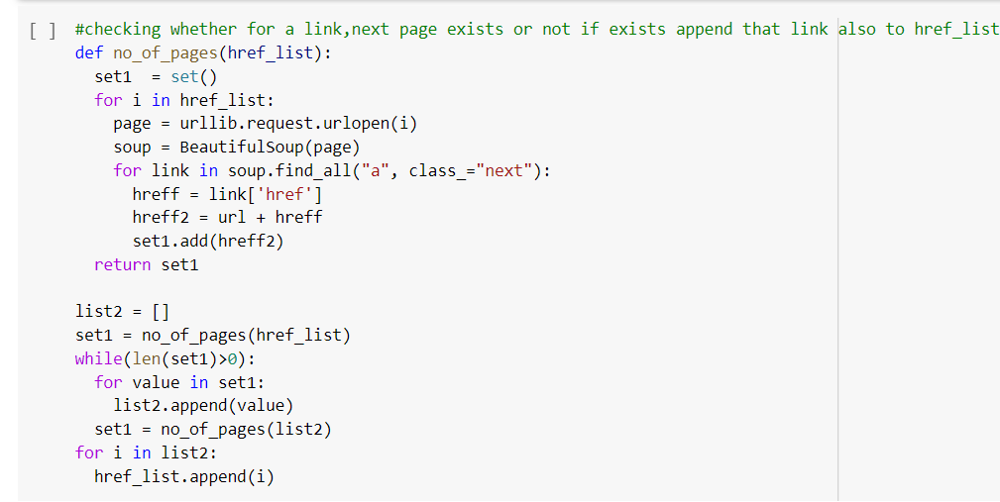
Data Retrieval Process and Results
Process 1
locating content that is hidden within the HTML structure.
urlib.request module is used to make a request to the website.
This step helps to get all the journal links from the given webpage link and the next step is to get into the journal links and collect all the article links.

Slide 12
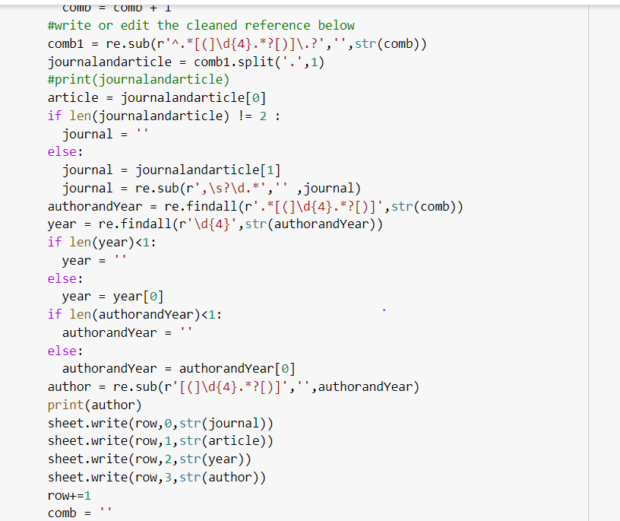
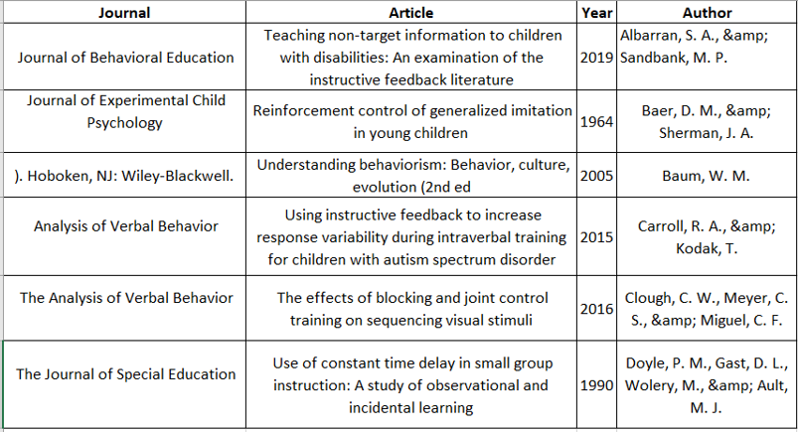
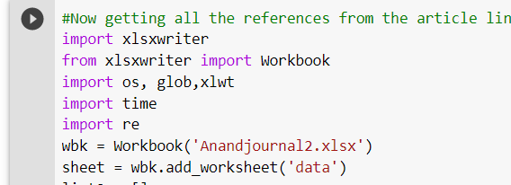
Data Retrieval Process and Results
After extracting the references, the final step here is to extract the author name, journal name, Article name and the year and put these in a structured format.
Each record is in the form of Author name(year). Article name. Journal name, pages
FINAL RESULT
The extracted attributes are written to the Excel Worksheet using the xlswriter
To extract the attributes individually various regex are used.

Slide 13
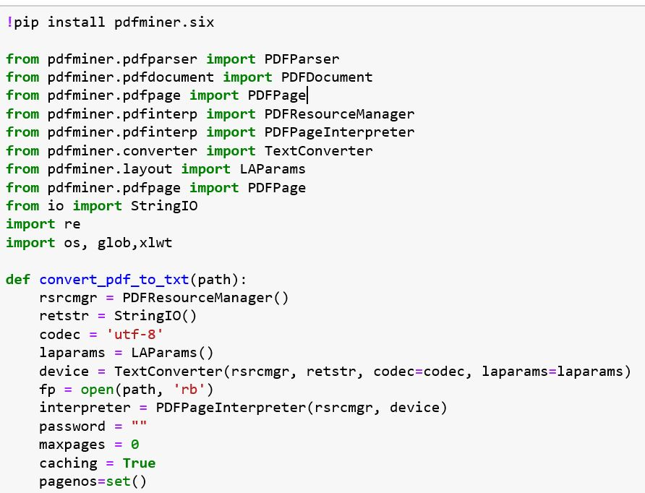
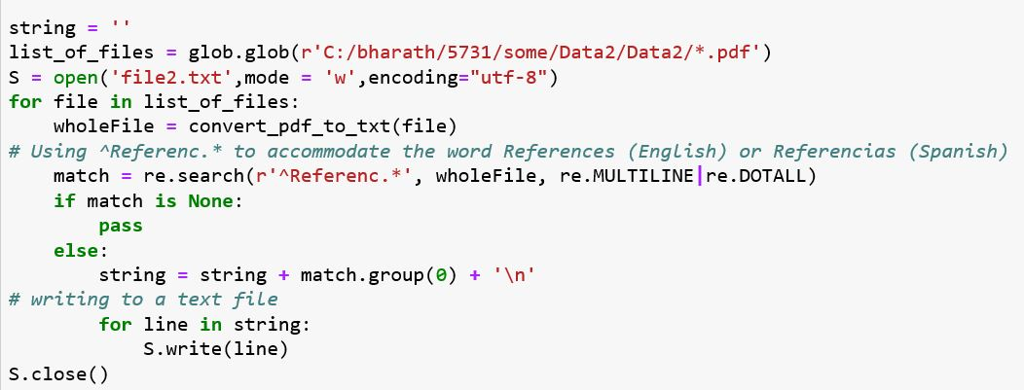
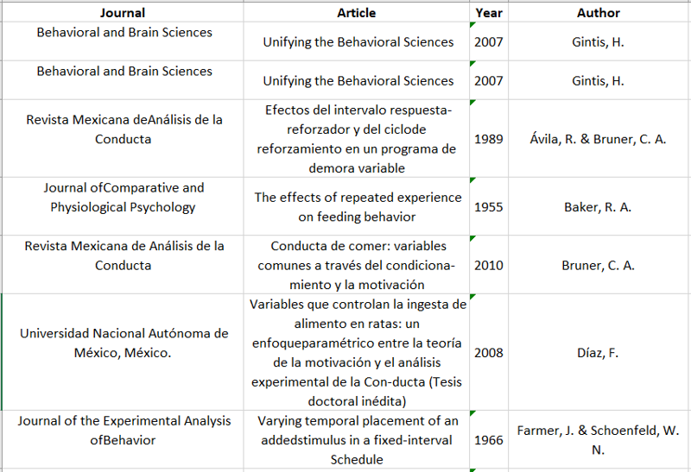
Data Retrieval Process and Results
Once all references are extracted to the file, various regular expression patterns are used to extract Author, Year, Journal name and Article name and then finally written into CSV file.
Process 2
In this process we are extracting references using pdfpageinterpreter, text converter, pdfresourcemanager
from Journal :
Mexican Journal of Behavior Analysis
FINAL RESULT
pdfminer tool is installed and various packages like pdfpageinterpreter, text converter, pdfresourcemanager are imported to convert data into text file and extract the references from them.
Here all the pdf files are saved in folder and each file is iterated, then data is converted into the text document and the reference are extracted from that data.

Slide 14
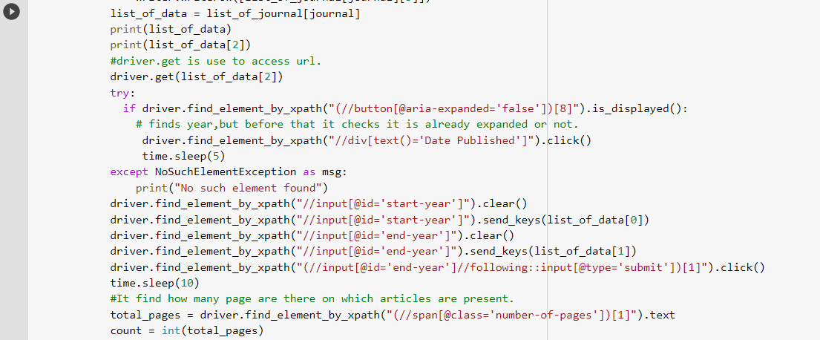
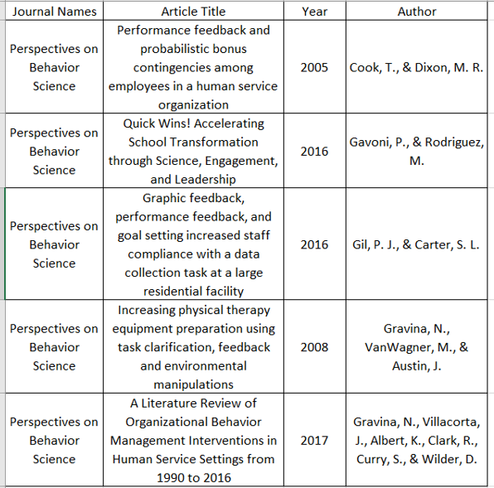
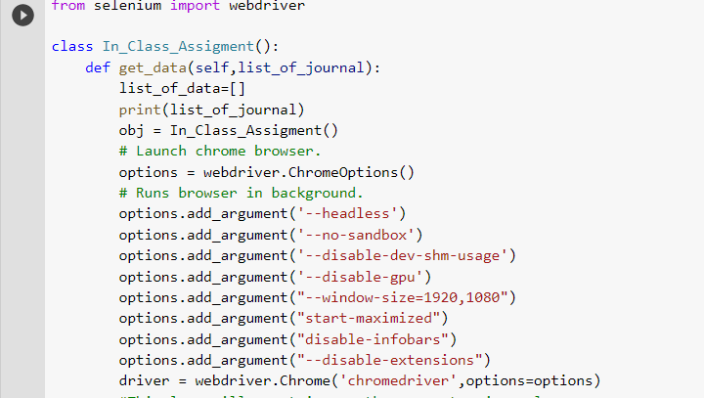
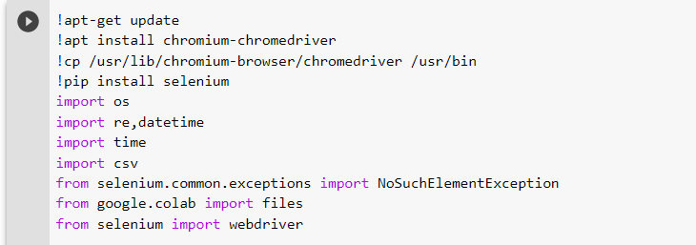
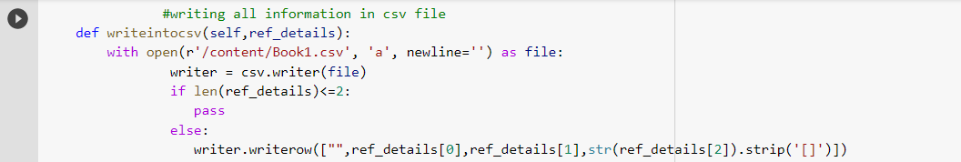
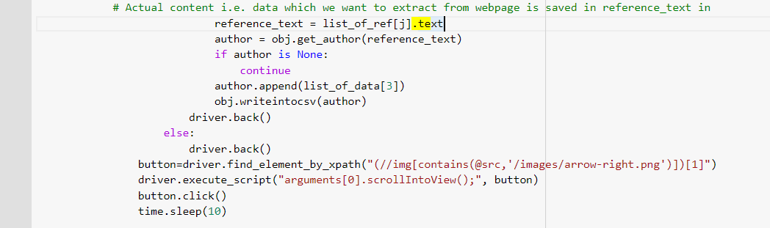
Data Retrieval Process and Results
FINAL RESULT
Process 3
In this process we are extracting references using Selenium from below Journals
Launching Browser and performing all browser operations
Driver.get is used to access url which we have mentioned
Once location of data is accessed, it is extracted and stored in text form.
Installing chrome driver and Selenium Packages
Once all data is stored in text form,that data is written into csv file
Journal of Applied Behavior Analysis
Journal of the Experimental Analysis of Behavior
Perspectives on Behavior Science
Psychological Record
X paths gives location of data which we want to extract

Slide 15
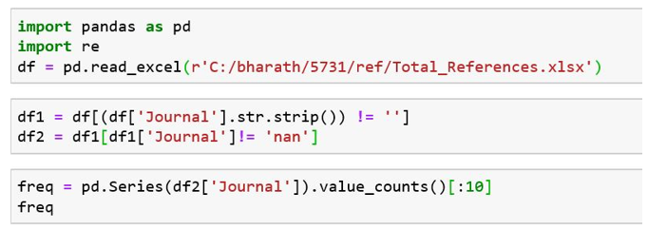
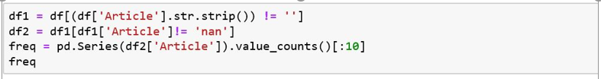
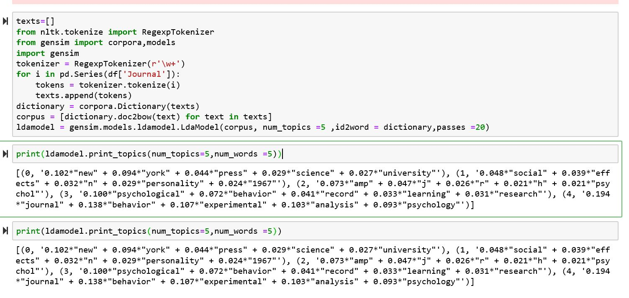
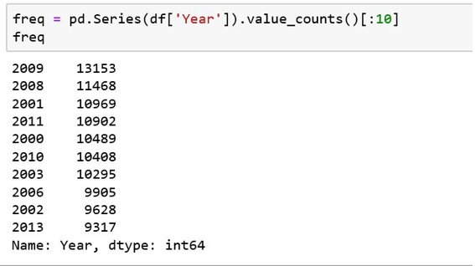
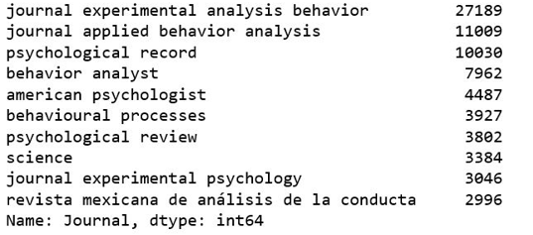
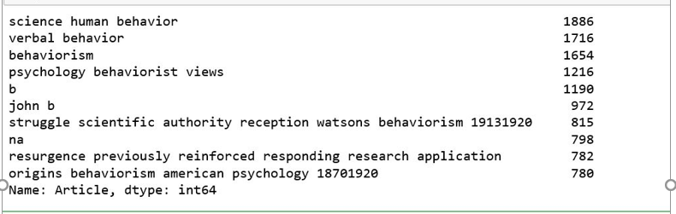
Data Analysis
Journals that have appeared frequently.
Articles that have appeared frequently
Article Topic Modeling.
Data analysis is a process of inspecting, cleansing, transforming and modeling data to discover useful information, informing conclusion and supporting decision-making. The results of the data analysis in this project will provide multiple facets and approaches that will help to make the decisions more scientific.
We have Conducted four types of data analysis i.e.
Article Topic Modeling.
Journals that have appeared frequently.
Articles name that have appeared frequently.
Year in which most of the articles are published.
Year in which most of the articles are published
Result
Result
Here we are conducting LDA for finding reasonably accurate mixture of topics within a given document set.

Slide 16
Conclusion
References are collected from articles by scraping web pages of Journals published on springer.com and onlinelibrary.wiley.com using beautiful soup package, Selenium and Regular expressions.
All the extracted references are then saved in CSV file and data analysis is performed and number of frequently appeared articles name are calculated.
Dissertation is being applied to delineate the formal and informal dissemination artifacts and identified how many are accessible by these behavior.

Slide 17
Code and Result Repository
https://github.com/tejask666/Tejas_INFO5731_Spring2020/tree/master/tejask666/Tejas_INFO5731_Spring2020/INFO%205731_Project_Team_Project

Slide 18
References
Dhankhad, S. (2019, April 01). Forget APIs Do Python Scraping Using Beautiful Soup, Import Data File from the web: Part 2. Retrieved May 04, 2020, from https://towardsdatascience.com/forget-apis-do-python-scraping-using-beautiful-soup-import-data-file-from-the-web-part-2-27af5d666246
Huang, H. (2019, June 18). Quick Web Scraping with Python & Beautiful Soup. Retrieved May 04, 2020, from https://levelup.gitconnected.com/quick-web-scraping-with-python-beautiful-soup-4dde18468f1f
Pocs, M. (2020, February 20). Web Scraping with Selenium in Python. Retrieved May 04, 2020, from https://levelup.gitconnected.com/web-scraping-with-selenium-in-python-8fde2f0fd559
Python - Regular Expressions. (n.d.). Retrieved May 05, 2020, from https://www.tutorialspoint.com/python/python_reg_expressions.htm

Slide 19
Thank You

